Slide 1

Relaunch of the UT AUSTIN AAUP Advocacy Chapter
Conveners: Brian Evans and Pat Somers

Slide 2
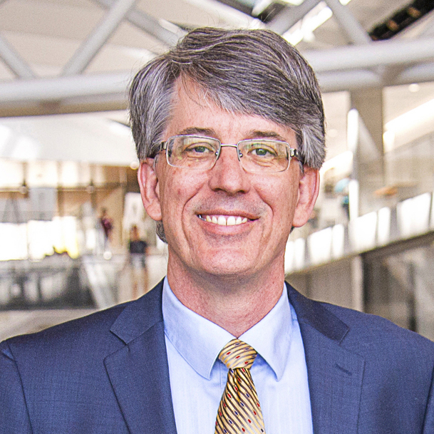
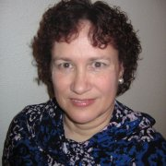
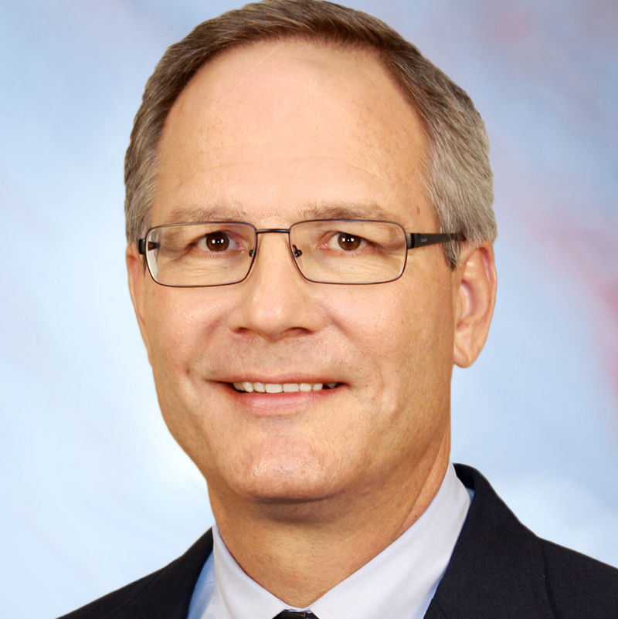
WELCOME
Brian Evans
Professor, Engineering
Pat Somers
Assoc. Prof., Education
Jeff Blodgett
Texas AAUP Conf. Pres.
Professor, Business University of Houston-Victoria
UT Austin Conveners

Slide 3
American Association of university professors - Mission
Per AAUP’s mission, our chapter will seek to bring together the campus community of students, staff, faculty, and administrators
to advance academic freedom and shared governance
to define fundamental professional values and standards for higher education
to promote the economic security of faculty, academic professionals, graduate students, post‐doctoral fellows, and all those engaged in teaching and research in higher education;
to help the higher education community organize to make our goals a reality; and
to ensure higher education's contribution to the common good.

Slide 4
FALL LAUNCH
Why an AAUP chapter at UT Austin?
AAUP national and Texas AAUP Conference provided guidance
Preparation over the summer
  Attended AAUP Summer Institute
  Reached out to AAUP members on campus to ask about their concerns
  Planned kickoff event for UT Austin
AAUP national meets in November to recognize new chapters (500 current ones)

Slide 5
CHAPTER By-LAWS (separate SLIDES)

Slide 6
OFFICER NOMINATIONS & ELECTIONS
Officer nominations
  Send e-mail to Brian Evans and Pat Somers through Friday, Oct. 15, 2021, 5pm
  Nominee eligibility: AAUP national member affiliated with UT Austin
Officer elections
  Held through electronic voting Oct. 18-22, 2021.
  Voting eligibility: AAUP national member affiliated with UT Austin
UT Austin affiliation would be as a full- or part-time faculty member (tenure-track, tenured, professional), academic professional, researcher, and/or graduate student

Slide 7
EXAMPLE AREAS of concern
(part 1)
Shared governance in departments, colleges/schools and university-wide
Academic freedom in teaching, scholarship and expression
Academic freedom safeguards including due process, shared governance & tenure
Racial justice, gender equity, and their intersections
Health and safety on campus
Evaluation and salary equity for tenure-track, tenured and professional faculty
Fostering collaboration with on-campus, statewide & national organizations

Slide 8
BRAINSTORMING ON AREAS AND ISSUES OF CONCERN (PARt 2)
Liberty institute – lack of transparency, history, donors. Texas Tribune article
Effectiveness of the committee of counsel on academic freedom and responsibility (CCAFR) as a university-wide elected faculty committee
  Investigates allegations of procedural violations and/or academic freedom principles in faculty evaluations
  Changes in university tenure, promotion, annual, comprehensive review policies
  Had a record 10 appeals from faculty concerning their promotion cases (for reference, 23 cases appealed over 2009-2018).
  President sided against CCAFR recommendations concerning case outcomes
  Shared governance and academic freedom concerns
  Lack of transparency in President Committee’s decision on tenure/promotion cases

Slide 9
BRAINSTORMING ON AREAS AND ISSUES OF CONCERN (part 3)
Proposed state legislation (but didn’t pass)
  Bill to accelerate pace of comprehensive post-tenure review from every six years to four years
  Bill to revoke tenure for any tenured faculty member who files a civil lawsuit against a student enrolled at the same institution
Other statewide organizations that Texas AAUP Conference works with includes
  Texas Faculty Association
  Texas Association of College Teachers

Slide 10
BRAINSTORMING ON AREAS AND ISSUES OF CONCERN (part 4)
Other proposed state bills (didn’t pass)
  Restrictions of types of litigation that can originate from public universities (would hamper ability of law clinics from representing clients in cases)
Professional faculty promotion and salary equity
  Lack of recourse in promotion and stability of employments
  Salary equity when professional faculty are teaching key courses in the undergraduate and graduate curriculums and yet have major salary gaps

Slide 11
BRAINSTORMING ON AREAS AND ISSUES OF CONCERN (part 5)
Family and medical leave – lack of clarity and its impact on promotion
ADA accommodations – lack of clarity, impact on promotion, and lack of retaliation (e.g. recent Colin College case) – new Provost committee formed
COVID policies for students, staff, faculty – changes every semester; lack of clarity
Shared Governance – Long delays in proposing changes to policies – delay tactic – everything is filtered through the Office of the VP of Legal Affairs. Some delays due to external pressure (e.g. state legislature action). Delay tactics work against shared governance. Demoralizing.

Slide 12
BRAINSTORMING ON AREAS AND ISSUES OF CONCERN (part 6)
Academic Freedom
  Code of conduct / community standards
  Intermingling of speech and conduct – e.g. burning the American flag. Complicated to disentangle speech and conduct.
  Recusal from committees
  Role of faculty to define what is appropriate and inappropriate conduct
  AAUP Statement on Professional Ethics
International scholars – Scholars at Risk – e.g. scholars in Afghanistan

Slide 13
BRAINSTORMING ON AREAS AND ISSUES OF CONCERN (part 7)
Remove the use of NDAs for committee work / requirement of secrecy
Faculty should decide which faculty to serve on different committees
Faculty members on the committee should be able to report back
Faculty release time for significant committee work
Help people to know their rights and help defend rights
Critical race theory
No search when appointing President Hartzell

Slide 14
PANEL ON SHARED GOVERNANCE
Separate slides

