Slide 1
Panel on
Shared Governance Principles
UT Austin AAUP Chapter Kickoff
Sept. 27, 2021

Slide 2
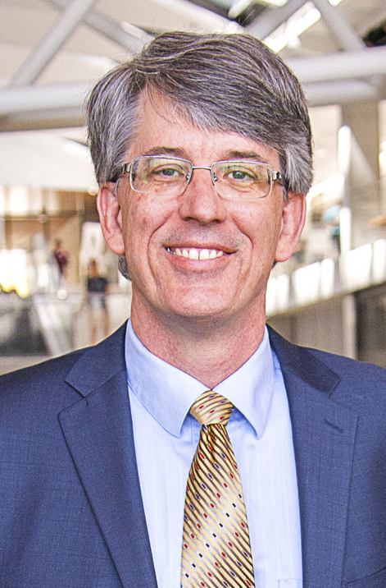
Brian L. Evans, Ph.D.
Moderator
Professor, Electrical & Computer Engineering, Cockrell School of Engineering, UT Austin
UT Austin: Faculty Council Chair 2019-20; Committee of Counsel on Academic Freedom & Responsibility (2008-14; 2015-19; Chair 6 years)
AAUP: Member since ’05
Texas Council of Faculty Senates: Exec. Committee 2018-21
Research: Signal processing and machine learning to increase data throughput, coverage, and reliability for fifth-generation (5G) and sixth-generation (6G) cellular communication systems
Joined UT Austin in 1996
Degrees: PhD & M.S. Electrical Eng. (Georgia Tech); B.S. Electrical Eng. and Computer Science (Rose-Hulman Inst. Tech.)

Slide 3
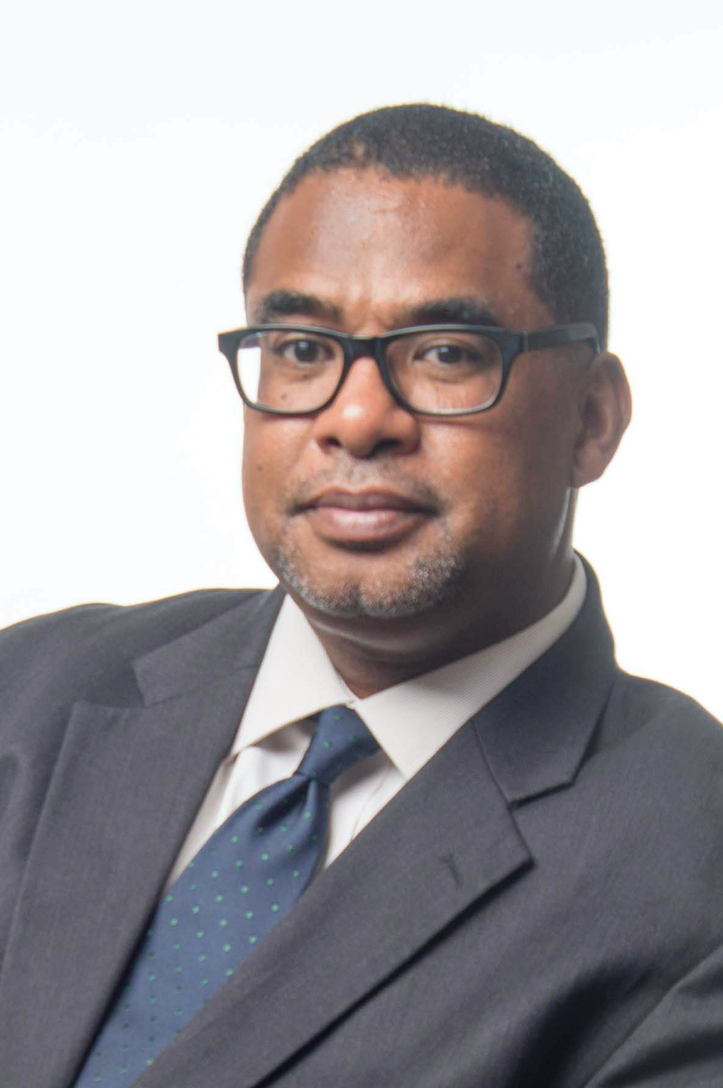
Anthony L. Brown, Ph.D.
Panelist
Professor, Curriculum & Instruction, College of Education, UT Austin
UT Austin Affiliations: John Warfield Center of African and African American Studies, Dept. of African and African Diaspora Studies
UT Austin: Faculty Council Chair 2020-21
Research: Historical and contemporary issues and discourses concerning African American students in schools and society; how educational stakeholders make sense of and respond to the educational needs of African American male students; historical experiences of African Americans in official school knowledge (e.g. standards and textbooks) and within popular discourse
Joined UT Austin in 2006
Degrees: PhD Curriculum & Instruction (Univ. of Wisconsin-Madison); M.A. & B.A. Political Science (California State University-Long Beach)

Slide 4
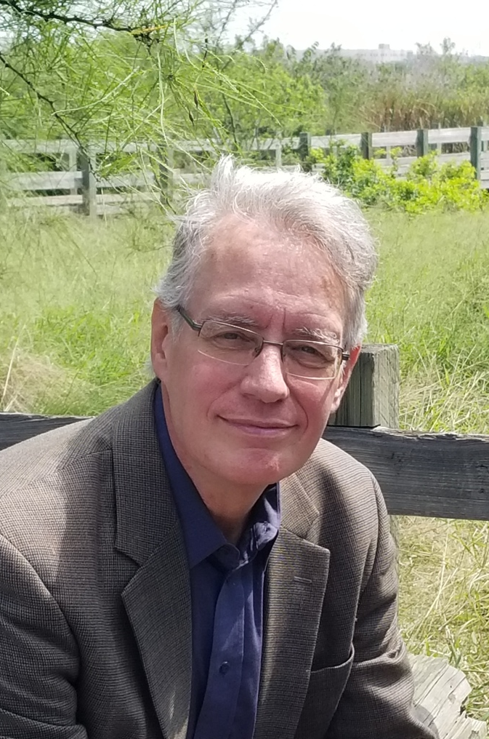
Jim Klein, PhD
Panelist
Professor, History, Del Mar College, Corpus Christi, TX
AAUP: Member since ’07; President Texas Conference 2014-20
Texas Association of College Teachers: President 2020-present
Research: Role of economic class, race, ethnicity, and gender in American society in the campaign leading to, and criminal enforcement during, the prohibition of alcoholic beverages in the early 20th century
Joined Del Mar College in 2006
Degrees: Ph.D. American History (Oklahoma State); M.A. History (Univ. of Iowa); B.A. History and Journalism (Univ. of Iowa)

Slide 5
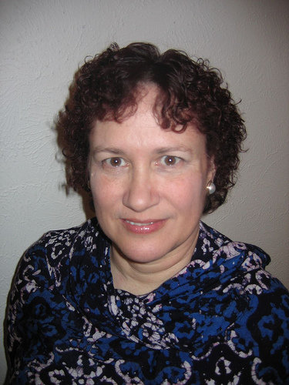
Pat Somers, Ph.D.
Panelist
Associate Professor, Program in Higher Education Leadership, Education Leadership, College of Education, UT Austin
UT Austin Affiliations: Center for Women’s & Gender Studies, Lozano Long Institute of Latin American Studies, Brazil Center
UT Austin: Committee of Counsel on Academic Freedom & Responsibility (2021)
AAUP: Member since ‘92, Texas Conference Officer since 2006
Research: college student/faculty experience, academic professionals, governance, academic freedom, campus carry, affirmative action in Brazil, Russia, India, China, and South Africa, presidential decision-making, COVID/higher ed futures
Fulbright Fellow: Brazil, Thailand, Germany, New Century Scholar
Joined UT Austin in 2004, previously Denison, Tulane, Arkansas, Missouri, and New Orleans
Degrees: Ph.D. Education (Univ. of New Orleans); M.A. Portuguese (Illinois); B.A. Spanish (Michigan State)

Slide 6
Shared governance (2016)
Dr. Brian L. Evans
Shared governance as organizational leadership [1]
  Collegial, cooperative, and trust-based organizational leadership
  Enables meaningful combined participation by administration and faculty in the management of an institution’s operations
Six components [1]
  An institution-wide commitment from all stakeholders
  An organizational culture of caring, mutual respect, and trust
  Open, bidirectional, and transparent communication without fear of reprisal
  Elected faculty governance org recognized institution-wide as the voice of faculty
  Partnership, shared responsibility, shared accountability in decision-making for all academic, clinical & research matters; shared accountability for other decisions
  A proclivity for action and persistent follow-up on all institutional decisions
[1] UT System Faculty Advisory Council, “Shared Governance at the University of Texas System Institutions: A White Paper”, 2016

Slide 7
Moderator’s questions
[Anthony] How do you recommend overcoming the barriers to faculty understanding and valuing the importance of shared governance?
[Jim] What role do you see the AAUP playing at the University of Texas?
[Pat] AAUP did a national survey of faculty senates on how the pandemic affected shared governance. How did the survey define shared governance and what were the findings?

Slide 8
Valuing shared governance
Dr. Anthony L. Brown
Three barriers to faculty understanding and valuing the importance of shared governance
  Ambition
  Apathy
  Anger

Slide 9
Shared governance
Dr. Jim Klein
Creates a tripod of leadership on campus-- faculty, administration, regents/trustees
  Vital for the institution to function effectively
  Statement on Government of Colleges and Universities jointly formulated by the AAUP, the American Education Council, and the Association of Governing Boards of Universities and Colleges
  All committees should have faculty members appointed by faculty
  Faculty committee members should report back to faculty
References
  American Association of University Professors. Policy Documents and Reports, Eleventh Edition. Washington, D.C.: Johns Hopkins University Press, 2015.
  American Association of University Professors. “Resources on Governance.” AAUP. Accessed September 26, 2021. https://www.aaup.org/.

Slide 10
Shared governance
Dr. Pat Somers
Academic capitalism - authority shifted to administration
  Influenced by administration shift to primarily non-tenure track faculty and force majeure precedents following Hurricane Katrina
Disaster capitalism - “Never waste a good pandemic” (White, 2020)
Faculty have primary decision-making authority per AAUP governance policy for:
  Curriculum
  Subject matter and methods of instruction
  Those aspects of student life which relate to educational process
  Matters related to faculty status – appointments, reappointments, decisions not to reappoint, promotions, granting of tenure, dismissal
Faculty have authority/participation at every stage for financial exigency and program closure decisions

Slide 11
Additional Reading
Dr. Pat Somers
AAUP. (2021). Special report – COVID-19 and academic governance. https://www.aaup.org/special-report-covid-19-and-academic-governance.
AAUP. (2007). Report of an AAUP Special Committee: Hurricane Katrina and New Orleans Universities. Academe, May–June, 61.
AAUP. (1966). The Statement on Government. https://www.aaup.org/report/statement-government-colleges-and-universities. (With the American Council on Education and the Association of Governing Boards of Universities and Colleges).
AAUP. Other relevant policies: Financial Exigency, Academic Governance, and Related Matters (2004), On Institutional Problems Resulting from Financial Exigency: Some Operating Guidelines (1978), On the Relationship of Faculty Governance to Academic Freedom (1994), The Role of the Faculty in Budgetary and Salary Matters (1972), and Statement on Academic Government for Institutions Engaged in Collective Bargaining (1988). (Available at www.aaup.org)
Alexander, B. (2020). Academia next: The futures of higher education. Johns Hopkins Press.
Alexander, B. (2022). Universities on fire. Johns Hopkins Press. (universities and climate research)
Bauman, D. (February 5, 2021). A Brutal Tally: Higher Ed Lost 650,000 Jobs Last Year. Chronicle of Higher Education. https:// www.chronicle.com/article/a-brutal-tally-higher-ed-lost-650-000-jobs-last-year (13 percent of the higher education workforce).

Slide 12
Additional Reading
Dr. Pat Somers
Lee, E., Somers, P., Taylor, Z., & Fry, J. (2021). Academic professionals: The changing face of tenure, research, and service in the American research university. Policy Futures in Education. doi.org/10.1177/14782103211031500
LePore, J. (2014). The disruption machine. The New Yorker, 29–32.
Rhoades, G. (1998). Reviewing and rethinking administrative costs. In: Smart J. C. (ed.) Higher Education Handbook of Theory and Research. New York: Agathon Press, 111–147.
Rhoades, G. (2006). The higher education we choose: A question of balance. The Review of Higher Education, 29(3), 381–404.
Rhoades, G. (2014). Extending academic capitalism by foregrounding academic labor. In: Cantwell, B., Kauppienen, I., & Slaughter, S., (eds) Academic Capitalism in an Age of Globalization. Baltimore: Johns Hopkins University.
Rhoades G, Kiyama JM, McCormick R and Quiroz M (2008) Local cosmopolitans and cosmopolitan locals: New models of professionals in the academy. The Review of Higher Education 31(2): 209–235.
Rosser, V. J., & Tabata, L. N. (2010). An examination of faculty work: Conceptual and theoretical frameworks in the literature. In: Smart J. C. (ed.) Higher Education Handbook of Theory and Research. New York: Agathon Press, 449–475.
Slaughter, S., & Rhoades, G. (2004). Academic Capitalism and the New Economy: Markets, state, and higher education. Baltimore, MD: The Johns Hopkins University.

