Slide 1


September 9, 2023
Texas AAUP / TFA Faculty Survey
Brian L. Evans
Interim President, Texas AAUP Conference
aaup.texas@gmail.com
In collaboration with Pat Heintzelman
President, Texas Faculty Association (TFA)
tfa.president@texasfacultyassociation.org

Slide 2
Survey Logistics
Survey
  Led by Matthew Boedy, Georgia AAUP
  Conducted by Georgia, North Carolina, and
  Texas AAUP plus TFA and United Faculty of Florida
  Open from Aug. 14, 2023, to Sep. 1, 2023
  9 demographic questions (all multiple choice)
  11 opinion questions (10 MC + 1 open-ended)
  Anonymous survey
Press releases: Regional - Florida - Georgia - North Carolina - Texas
News articles: Chronicle of Higher Ed - Texas Tribune - Houston Chronicle - Dallas Morning News - Reform Austin - Kera News
State | Respondents
FL | 642
GA | 1452
NC | 250
TX | 1907
TOTAL | 4251
UT Austin Libraries has subscription to Chronicle of Higher Ed: https://www-chronicle-com.ezproxy.lib.utexas.edu/

Slide 3
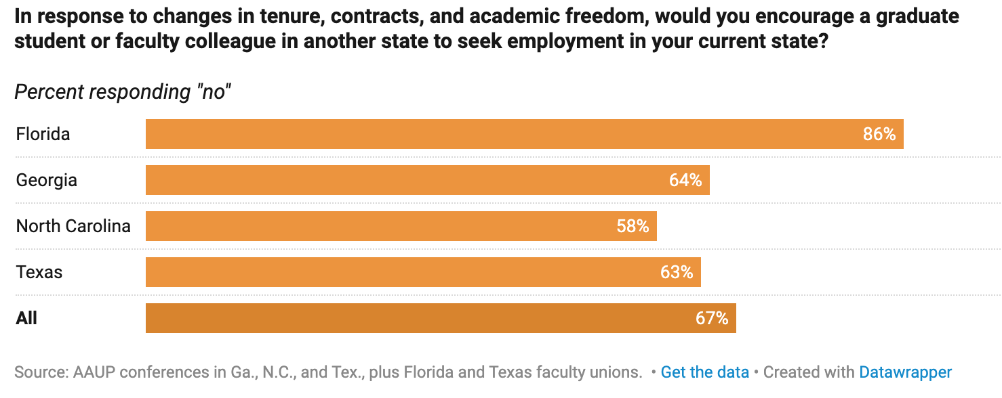
Survey Responses (1 of 2)
Summary
  About 2/3 do not recommend their state to colleagues as desirable to work
  About 1/3 are actively seeking academic jobs elsewhere
  About 1/5 have already interviewed for jobs in other states since 2021
4166 responded yes or no
85 did not answer
“In These Red States, Professors Are Eyeing the Exits”, By Megan Zahneis and Audrey Williams June, Chronicle of Higher Ed, Sep. 7, 2023.

Slide 4
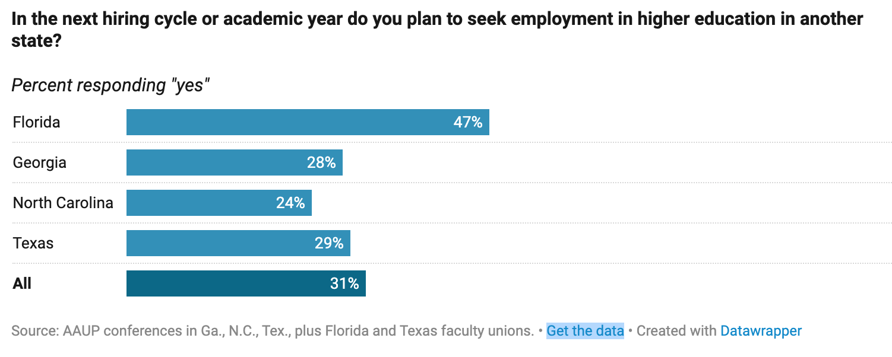
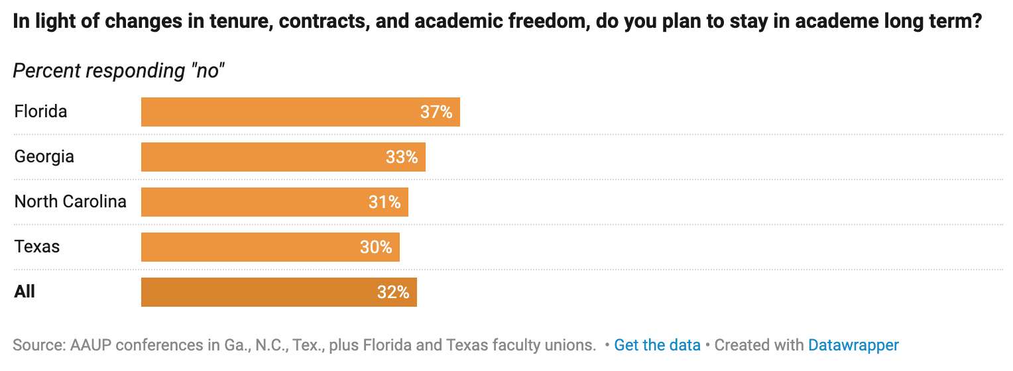
Survey Responses (2 of 2)
4179 responded yes or no
72 did not answer
4150 responded yes or no
101 did not answer
“In These Red States, Professors Are Eyeing the Exits”, By Megan Zahneis and Audrey Williams June, Chronicle of Higher Ed, Sep. 7, 2023.

Slide 5
Discussion of Additional Results from Texas Survey
Texas press release

